Slide 1
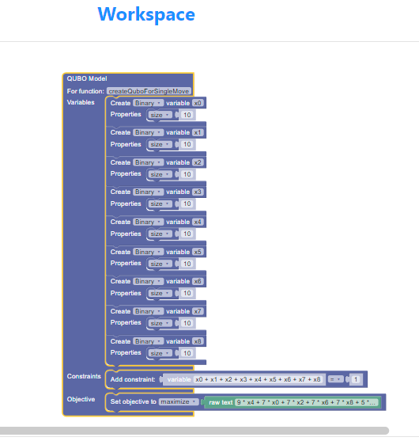
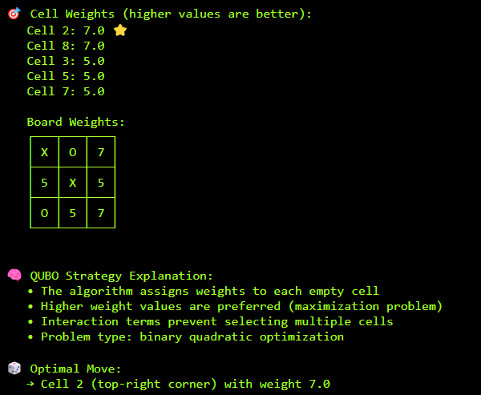

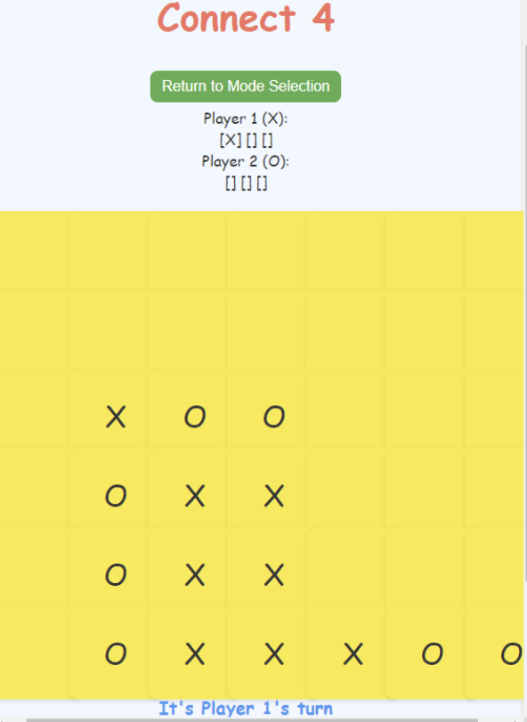
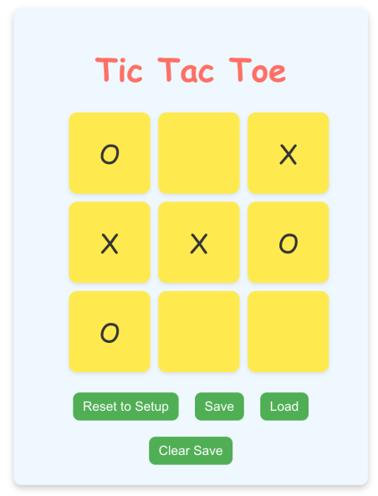
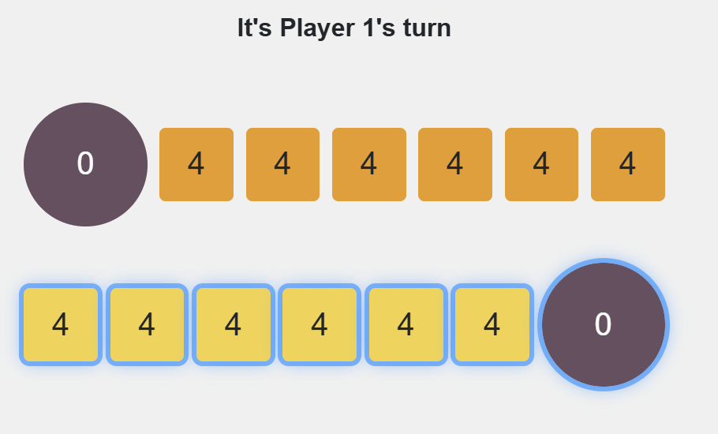
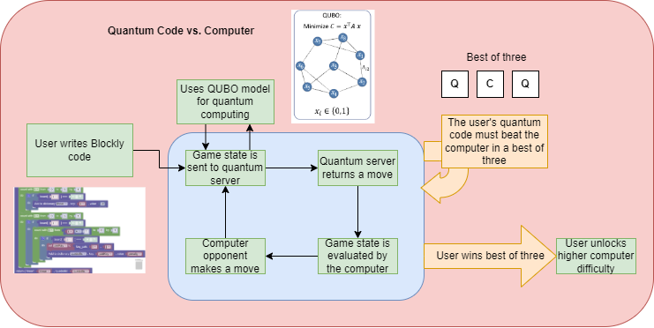






25-333
Quantum Computing for K-12 using Blockly
Team members: Joshua Pomeroy, Robert Duncan , Santiago Agudelo, Steven Acosta | Faculty adviser: Thang N. Dinh | Sponsor: VCU College of Engineering | Mentor: Thang N. Dinh
Motivation
Solutions
Block Based Quantum Code
To add new features, we’ll establish a structured development pipeline based on brainstorming, team feedback, and iterative testing.
To improve aesthetics, we modified the game’s design elements, including fonts and colors, making it visually stimulating and more enjoyable for students.
To be able to code new games, we familiarized ourselves be playing online versions of the game and understanding the nuances and similarities to TicTacToe.
Using local storage, we store the current game as an array, allowing students to resume where they left off. This system also enables switching between games.
Last year, a VCU Capstone team worked on a Quantum Computing with Blockly project to generate a basic TicTacToe game. This year, we wanted to far exceed what the previous team did and really showcase what we and Quantum Computing could do. We decided to do this by not only adding new features to TicTacToe like cpu vs quantum, but also devising new games with Blockly with different difficulties that would draw in a younger audience from K-12 by showcasing the different things you can do with Blockly in enticing fun to play games and hoping inspire an interest in the subject s they could study it and develop their own games and projects by using the concepts and mechanics of quantum computing.
New Features
User made block-based JS code sends variable and constraints to quantum server to generate a QUBO function and processes a move
Save-and-Switch: Players will be able to save their current game, switch between the different games and load up the saved game later
Mancala and Connect 4: The player can play these games now.
CPU Opponents: The player can play against a classic or quantum CPU opponent with adjustable difficulty and even CPU vs CPU.
Challenges
Feature Development: Designing and implementing new features requires ongoing creativity and technical expertise. New features need to be thoughtfully integrated into the original program to ensure compatibility and relevance.
Engagement-Focused Gameplay: Developing diverse games and new features to reinforce their learning in a fun, interactive way.
.
Game Development: Developing new games with different rules will be challenging as the displays and rules of the game to be coded will be more complex and unfamiliar
Programming Proficiency: Many students have limited experience in programming, making it challenging to introduce complex concepts, such as quantum mechanics.
Interdisciplinary knowledge: Developing educational games that engage students requires an interdisciplinary approach, incorporating physics, math, and computer science.
Current and Upcoming Games
Tic-Tac-Toe
Mancala
Architecture Design
Tools and Libraries

